Slide 1
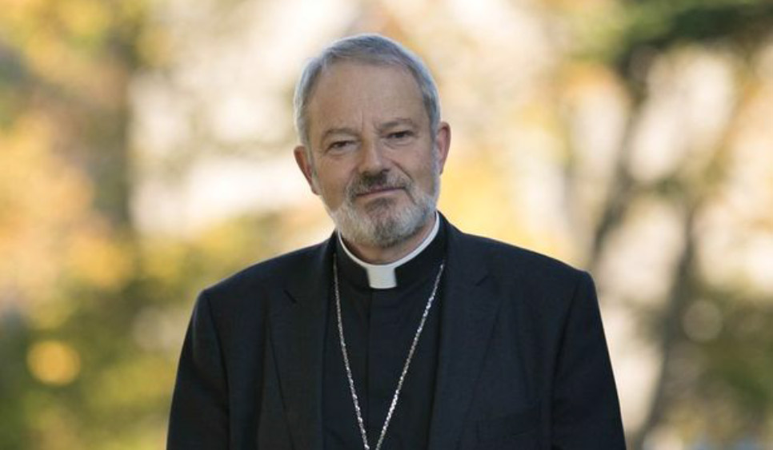
The Promise and Coming of the Holy Spirit
Confirmation 2021 A Preparation with Bishop Kevin Doran

Slide 2
Bishop Kevin’s Message to You

Slide 3
In the Gospel of John, Chapter 14, Jesus tells us, He will pray to the Father and ask Him to send us a “helper.”
Do you know Who that helper is?
Jesus is referring to the Holy Spirit!

Slide 4
The Holy Spirit is our Guide
Have you ever been on holidays and had a guide show you around? Or been lost, and had to be shown the way?
I’m sure the guide on your holidays knew a lot about what he or she was showing you.
In the same way, the Holy Spirit knows all about God and God’s plan for your happiness.

Slide 5
Our goal is to get to Heaven.
Not all “roads” lead there.
The Holy Spirit is from there;
He knows the way and
He will show us.

Slide 6
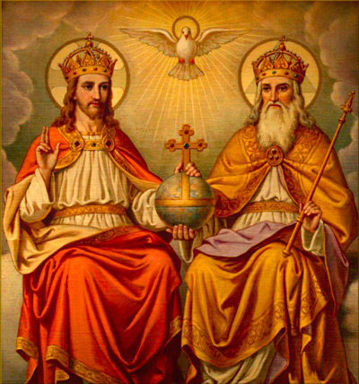
A Relationship
With the help of the Holy Spirit we can develop a close friendship with God.
God the Father - as our very own Father,
The Son (Jesus) - as our friend and saviour, and
The Holy Spirit our helper and life-giver.
Heaven isn’t a place; it is a relationship and,
like every relationship we need to work at it!

Slide 7
The Holy Spirit is also our Teacher
How is the Holy Spirit our teacher?
The Holy Spirit also teaches us about God. We can never understand God completely, but we can certainly get to know Him better.
Knowing God is not like knowing about things. It is like the way we know people. The Holy Spirit helps us to know God without hearts, not just our heads.

Slide 8
St Patrick
St. Patrick came from a very good Christian family. He tells us himself that, in the beginning, he didn’t share his parents’ faith. God didn’t mean very much to him. Everything changed for him when he became a slave in Ireland. He realized that he didn’t have all the answers. He started to talk to God (prayer). He started by asking for help and protection. Bit by bit Patrick would spend more time talking to God, and he soon realised that God was with him always and loved him very much!

Slide 9
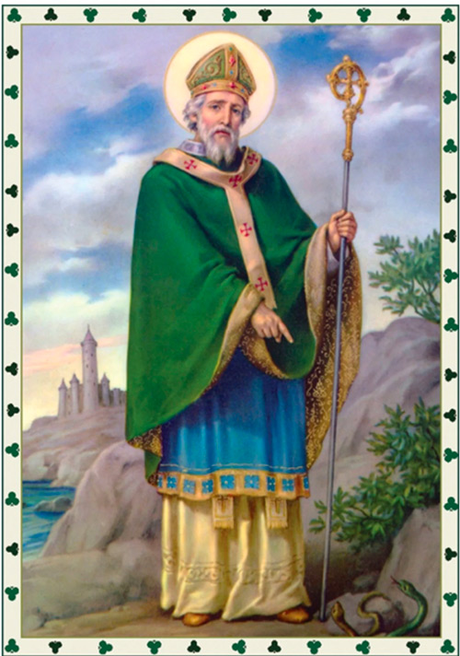
Maybe you know one of the prayers of St Patrick (called St. Patrick’s Breastplate). A breastplate is an important piece of armour that warrior wear to protect them. St Patrick knew that Christ was his protection.
(This is part of it)
Christ with me, Christ before me,
Christ behind me, Christ in me,
Christ beneath me, Christ above me,
Christ on my right, Christ on my left,
Christ when I lie down,
Christ when I sit down,
Christ when I arise,
Christ in the heart of every man who thinks of me,
Christ in the mouth of everyone who speaks of me

Slide 10
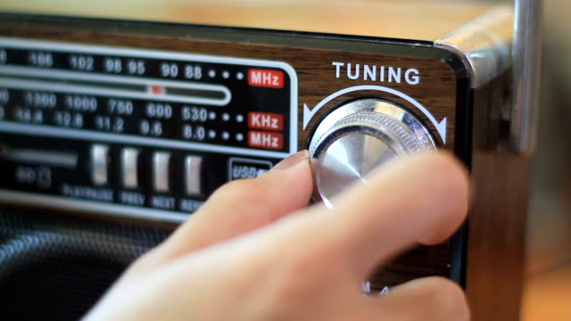
The Holy Spirit also teaches us to hear God’s voice. It’s not a voice like mine or yours. God speaks to us in our hearts, He speaks to us through Scripture, through the Mass, and through our surroundings.
God has so much to say to you, but you have to tune in to hear Him.
The Holy Spirit can help train our “ear”, so we hear what God wants to say to us.

Slide 11
God is the Source of Truth.
The Holy Spirit teaches us the truth.
The truth is we are children of God and He loves us VERY much! Living in that truth makes everything else fall into place.
Remember what Jesus told us:
“If you abide in me and I in you, you will bear much fruit, but apart from me you can do nothing.”

Slide 12
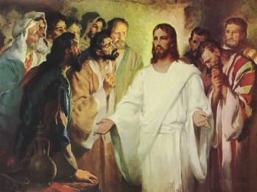
In the Gospel according to St. John, we read that after His Resurrection, Jesus breathed on His disciples, imparting the Holy Spirit and giving them the power to forgive sins! (John 20)

Slide 13
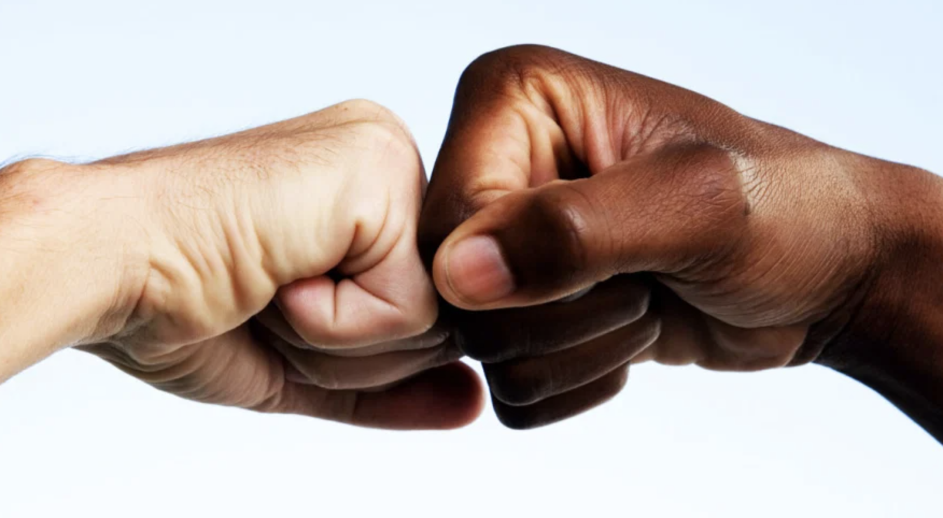
Jesus received the Holy Spirit at His Baptism, and He began His public ministry
Before the disciples are given their mission of reconciliation, they are given the Holy Spirt
We need the Holy Spirit so we can live out our mission.
In our life, the Holy Spirit can help us to be people of forgiveness.

Slide 14
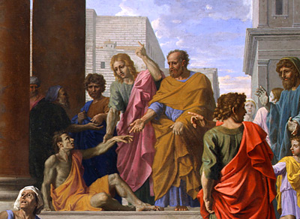
In the next slide we’ll be talking about the Acts of the Apostles
It comes right after the Gospels
It’s the Fifth Book of the New Testament
In it, we read all about the early
church and the work of the Apostles

Slide 15
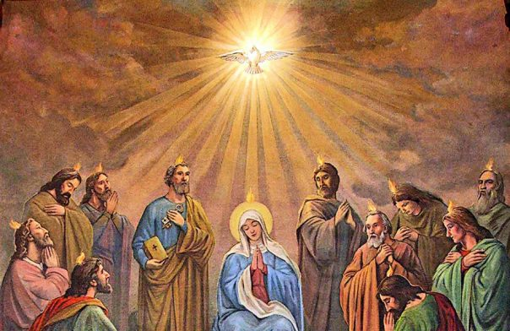
Pentecost.
Pentecost is when the Holy Spirit came down on the Apostles and the Virgin Mary in the form of tongues of fire. This out-pouring of the Holy Spirit allowed people to understand the testimony of the Apostles and to bring the good news of the Gospel back to the communities from which they came. (Acts, 2)

Slide 16
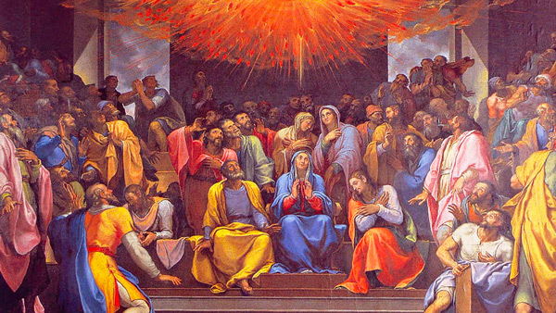
You might be thinking BUT WHO WERE ALL THOSE PEOPLE, and why were they gathered in Jerusalem on that particular day?
They were Jews, and they had gathered in Jerusalem to celebrate the “Feast of Weeks.” It was one of the “temple feasts” when devout Jews were supposed to travel, if possible, to the Temple in Jerusalem. It commemorates Moses’ receiving of the Law from God on Mount Sinai. On the Jewish calendar it is roughly fifty days (seven weeks) after Passover. Greek-speaking Jews referred to it by the name: Pentecost.

Slide 17
As St. Paul reminds us:
For just as the body is one and has many members, and all the members of the body, though many, are one body, so it is with Christ. For in one Spirit we were all baptised into one body—Jews or Greeks, slaves or free—and all were made to drink of one Spirit.
1 Cor. 12: 12-13

Slide 18
Did you know as members of the Catholic Church, you and I have the God-given mission to Evangelise??
You might be thinking, “I have that mission? I don’t even know what that means…”
To evangelise means to share your faith. Christians are called to bring the Good News of Jesus Christ to everyone. We can do it in simple ordinary ways wherever we are.

Slide 19
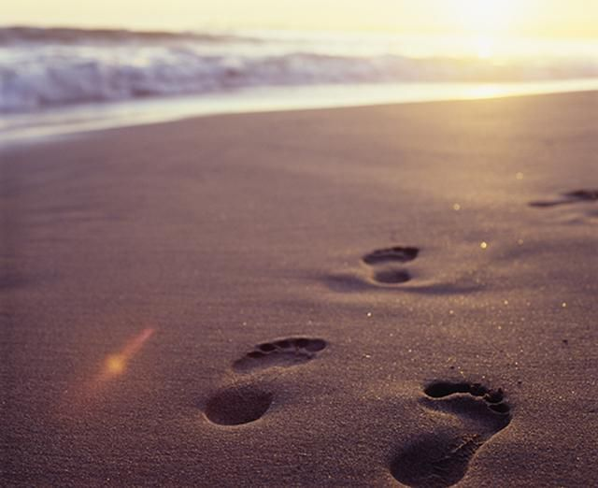
We are not all called to be preachers. We can express our faith by the way we participate in Mass, or by getting involved in the activities of the parish. Some of us may be teachers or parents, doctors and nurses, lawyers, politicians and people in business. We can evangelise simply by standing up for what we believe in and by our example.

Slide 20
We can start sharing our faith just by the very way we live, by our example.
Next, we have to be courageous enough to share the faith by talking about it with others. That’s why it’s so important to learn about your faith. You can’t share what you don’t know.

Slide 21
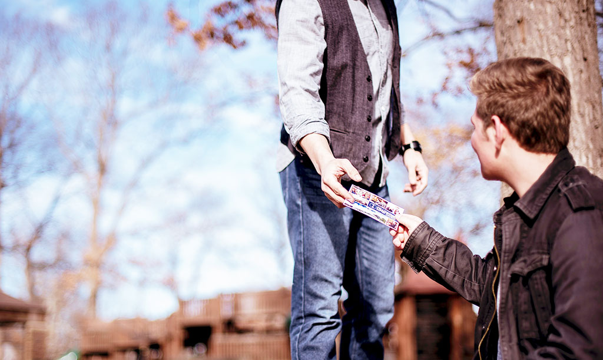
The Ends of the Earth
The Holy Spirit empowered the Apostles to bring the Gospel “to the ends of the earth”. Wherever you go, the Spirit will help you to be a witness to Jesus!
You won’t even have to go very far, you can start:
-at home
-at school
-with your friends
-with your teammates

Slide 22
The Holy Spirit Teaches us to Pray
Have you ever heard someone pray to the Holy Spirit? Call upon the Holy Spirit at all times, He can help us with everything.
“For all who are led by the Spirit of God are sons of God. For you did not receive the spirit of slavery to fall back into fear, but you have received the spirit of sonship. When we cry, “Abba! Father!” it is the Spirit himself bearing witness with our spirit that we are children of God…(Romans Chapter 8)

Slide 23
Ask the Holy Spirit’s help in getting
to know God as your Father!

