Slide 1
Confirmation 2020

Slide 2
This great Sacrament is when the Holy Spirit, the 3rd Person of the
Blessed Trinity comes to you in a new way to CONFIRM what you have already received at Baptism.
Dear Boys and Girls,
Many of you will soon be making your Confirmation!

Slide 3
DID you KNOW????
FATHER
We Believe in….
God is FATHER, SON, and HOLY SPIRIT
1 GOD, 3 PERSONS
IS
ONE GOD
3 Persons:
1. FATHER
2. SON
3. HOLY SPIRIT
IS NOT
IS NOT
Trinity
GOD
IS
IS
HOLY SPIRIT
SON
IS NOT

Slide 4
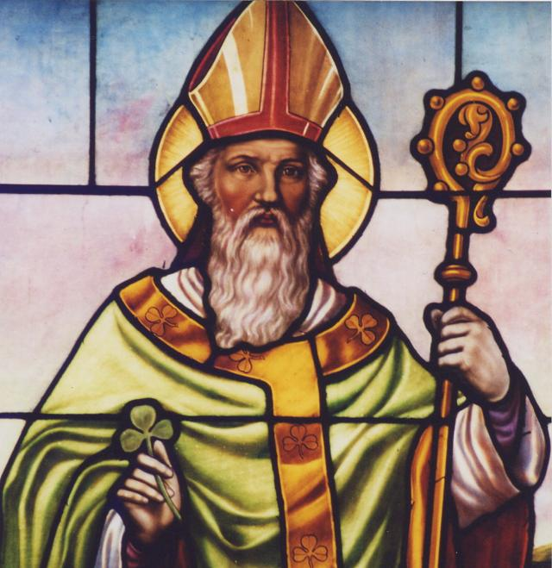
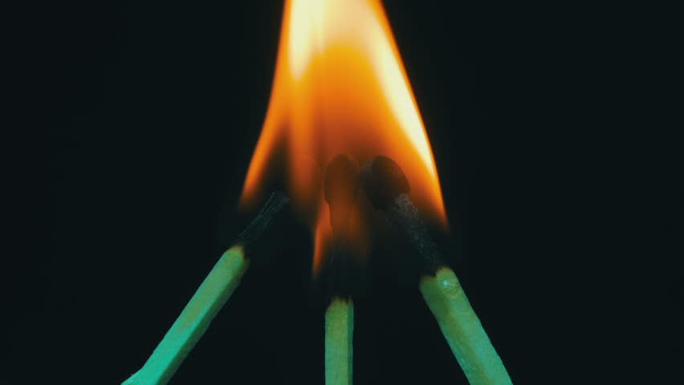
Still confused??
1 God, 3 Persons, TRINITY!
What do you see? Three matchsticks with just one flame. The Holy Trinity is something similar: 3 Persons, One God.
How many shamrocks do you see? Just one right? And how many leaves? 3!

Slide 5
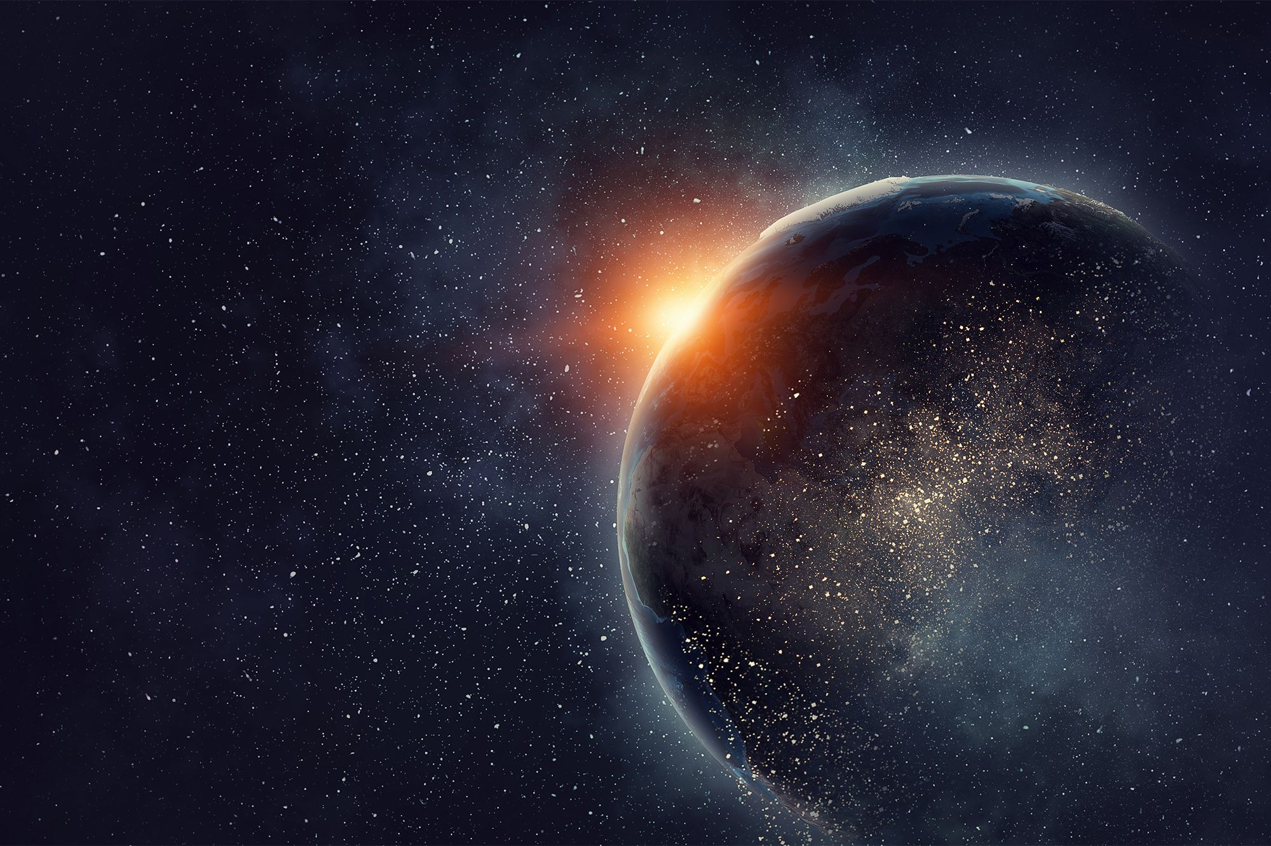
God the Father –
the Creator
God the Son-
the One who made Him known ( our Saviour)
God the Spirit-
who teachs us to live now as the people of God (through his many gifts)

Slide 6
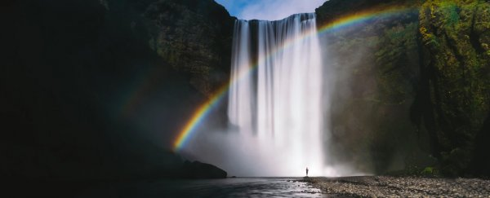
You see, when you were baptised, you already received the Holy Spirit;
you were made a CHILD of God and given the virtues of:
I hope that through these messages, you will see that the Holy Spirit is REAL, ALIVE, and can ACT in you in a powerful way to help in your life decisions.
FAITH
HOPE
CHARITY

Slide 7
We will be learning from the Bible, which is God´s own Word to us.

Slide 8
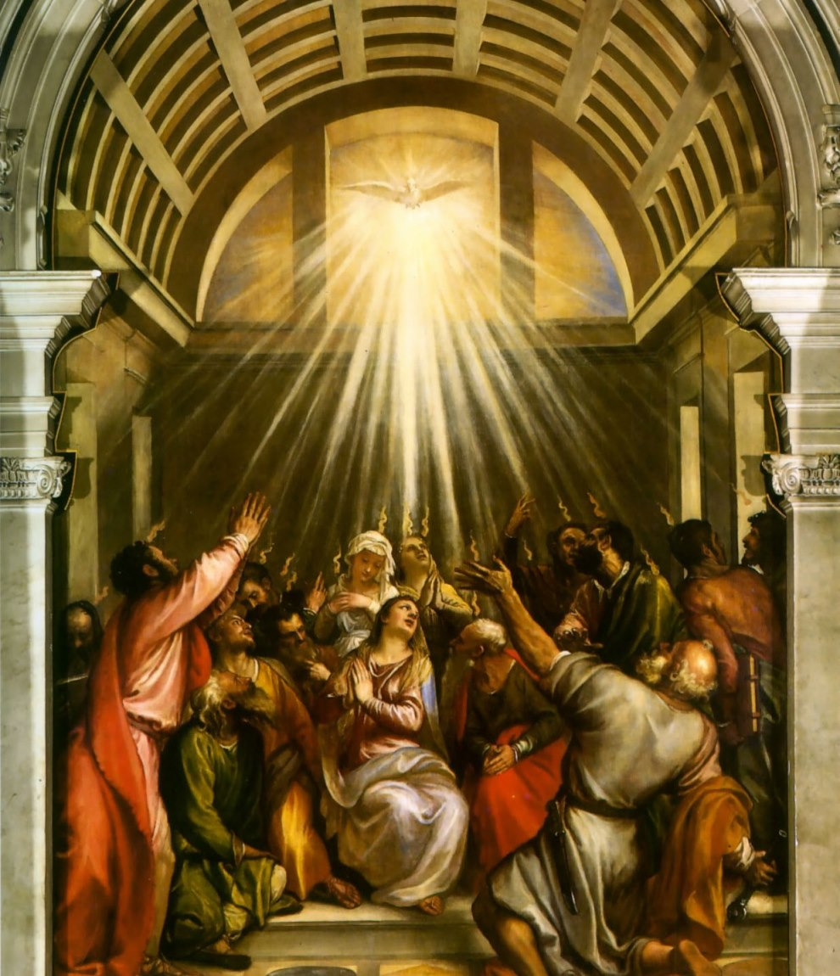
But, before we
begin…
Can you tell me what this picture represents?
This is a picture of Pentecost, when the Holy Spirit, the 3rd Person of the Trinity, came down upon the Apostles and Mary.

Slide 9
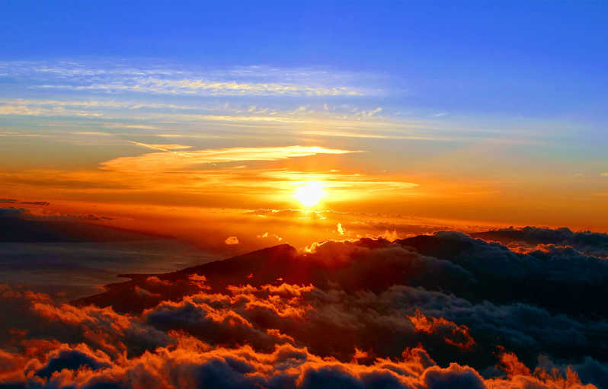
After Jesus died and rose on the 3rd day, the Apostles were very scared that they might be killed also.
The Holy Spirit came down upon the Apostles and on Mary to give them the strength and courage to speak boldly about their faith.
They became witnesses of Jesus Christ, telling others what they had seen: that Jesus who was crucified and died had risen as he promised.

Slide 10
Jesus says:
“I tell you, whoever publicly acknowledges me before others, the Son of Man will also acknowledge before the angels of God. But whoever disowns me before others will be disowned before the angels of God”.
“When you are brought before synagogues, rulers and authorities, do not worry about how you will defend yourselves or what you will say, for the Holy Spirit will teach you at that time what you should say.”
This passage talks about being a witness.
What does it mean to be a Witness?

Slide 11
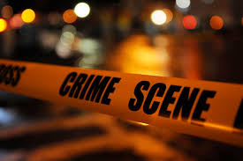
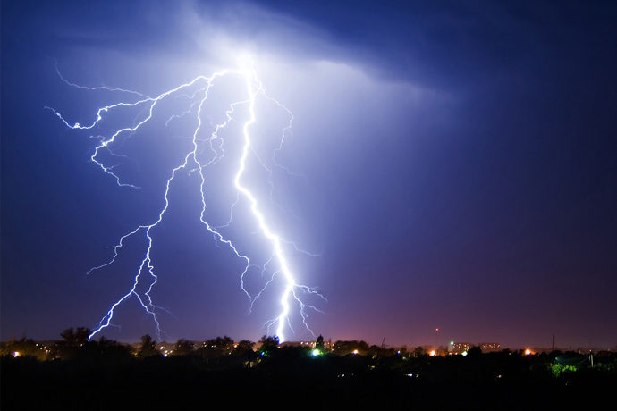
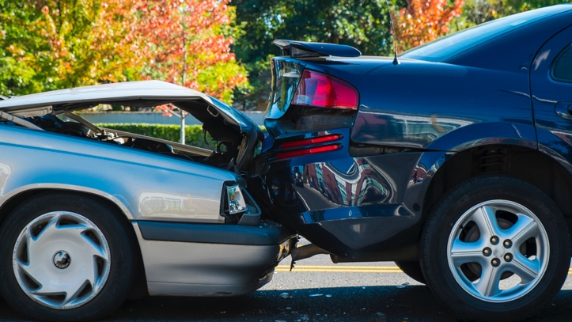
A WITNESS
Have you ever witnessed a natural phenomenon, like a storm? Have you been a witness to a car- accident or to a crime?
These witnesses later can go to Court to tell the truth of exactly what they saw.
They help represent the truth to what occurred.

Slide 12
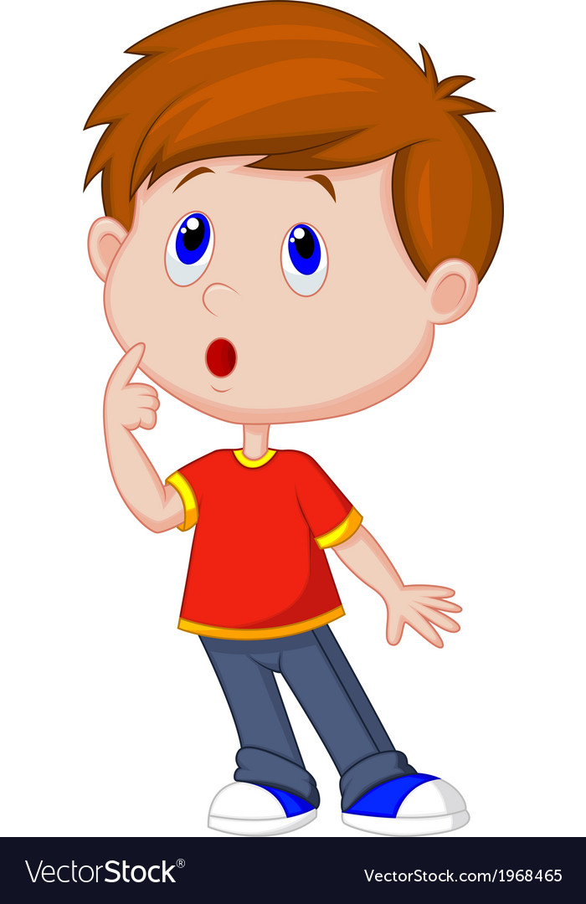
To be a witness, WHAT DO I NEED??
Honesty
Courage
Uprightness-
Committed to do what is right

Slide 13
What do you think??
Is it easy to tell the truth?
If you saw someone rob
an old lady, would you tell the truth and be a witness saying who the robber was?

Slide 14
The Holy Spirit can help us to:
give WITNESS, but in a different way:
to our Faith, to what we believe.
be honest, to speak courageously and defend our FAITH.
We might feel afraid but we are not alone. The Holy Spirit gives us the words that we need.

Slide 15
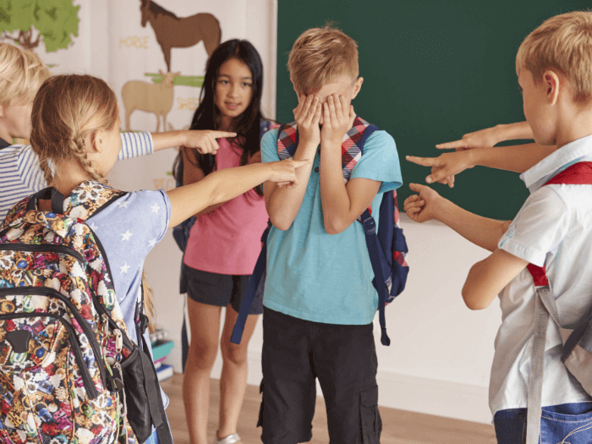
How can I be a witness to my faith?
Wear a cross around your neck,
carry rosary beads,
talk about your faith or God with your classmates,
go to Mass on Sundays even when there is a match on…
Have you ever been embarrassed to practice your faith in public?
The Holy Spirit can help!

Slide 16
Do you know who else was a witness for their faith and can help you?
The word “Martyr” is the Greek word for “witness” .
Martyrs are saints who have died because of their faith.
Martyrs are filled with the Holy Spirit to act bravely & to speak the truth.
They gave witness through their life and death and are now praying for us in heaven!
The saints!

Slide 17
The Martyrs can teach me
to be strong in my faith
Saint Perpetua and Saint Felicity were two Martyrs from the very beginning of the Catholic Church.
Once they heard about who Jesus was and that He is God and had risen from the dead, Saints Felicity and Perpetua converted to Catholicism. They wanted to be baptised Christians!
They believed that Jesus is God and were willing to give their lives to defend their faith.
Saint Perpetua & Saint Felicity

Slide 18
Let’s ask the Martyrs for help
TO BE WITNESSES!
Let us end with a Prayer:
Holy Spirit, you are the giver of many gifts which God wants to give me personally.
Open my heart and my mind as I prepare for Confirmation. Increase my desire to know and follow Jesus as his disciple with a grateful and courageous heart. Amen.

Slide 19
You are all in my prayers as you continue to prepare yourself for Confirmation! Remember to be a witness of Jesus and His love to those all around you - in your families, with your friends and classmates. I hope you pray every night that your faith will grow strong!

Slide 20
And don´t forget to watch my latest video message:
https://youtu.be/8eXtya2yVcY

