Slide 1
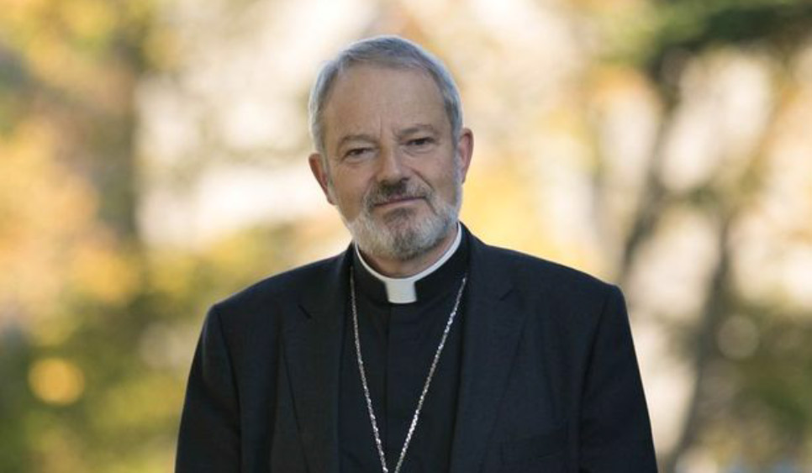
Message from Bishop Kevin

Slide 2
Dear Boys and Girls,
In Baptism, you became members of God’s family. In the sacrament of Confirmation, the Holy Spirit comes to you in a new way to CONFIRM the mission that began at your Baptism
Let’s get READY!

Slide 4
First things first, let’s get to know the Holy Spirit!

Slide 5
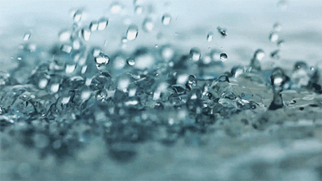
Wind
Fire
Dove
Water

Slide 6
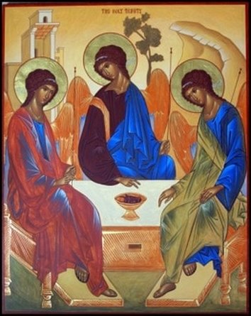
Fire, wind, water, and a dove are just a few of the many symbols of the Holy Spirit.
Each of these helps us understand different aspects and characteristics of the Holy Spirit.
The Holy Spirit is the 3rd person of the Holy Trinity, HE IS GOD.

Slide 7
There’s lots
to learn about the
Holy Spirit!
The Bible can teach us a lot!

Slide 8
Bible
The word Bible comes from a Greek word which means "books” because the Bible is composed of many books.
It includes the law of Moses, history, psalms, letters, and lots more. The Gospel teaches us about the life of Jesus.
It is the word of God, written by human authors BUT inspired by the HOLY SPIRIT!

Slide 9
It has two parts: The Old Testament and
The New Testament

Slide 10
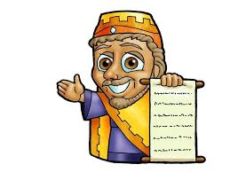
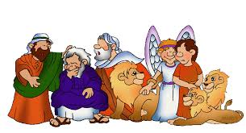
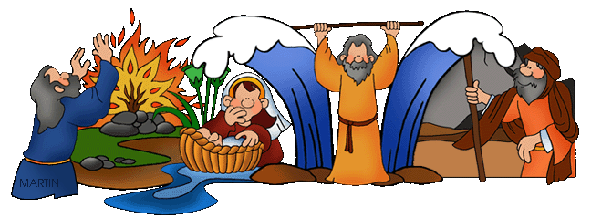
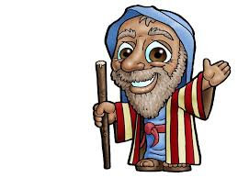
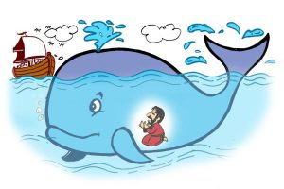
The Old Testament contains:
The story of creation
The law
History of the Israelites
The books of the prophets. The prophets call the people of God to conversion.

Slide 11
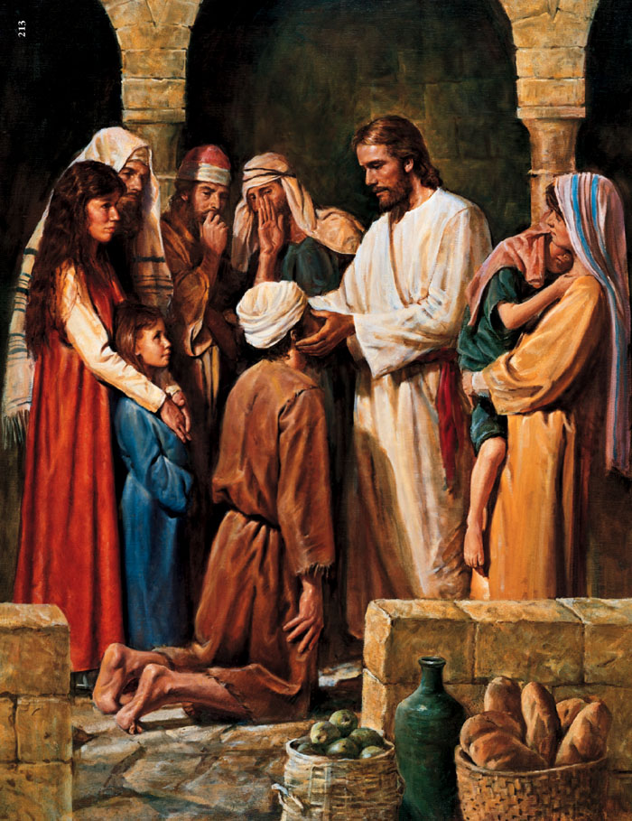
The New Testament Contains:
The Gospels- the life of Jesus, His teachings, miracles, crucifixion, death, resurrection, and ascension
The life of the first Christians
The Epistles- letters written from church leaders (St. Peter, St. Paul, St. John, etc.) the Christian communities in different places
The Book of Revelation

Slide 12
In this first presentation,
there are things
we will learn about the Holy
Spirit from the Bible

Slide 13
“The earth was without form and void, and darkness was upon the face of the deep; and the Spirit of God was moving over the face of the waters.”
-Genesis 1:2
Fun Fact:
Genesis is the first book
in the Bible

Slide 14
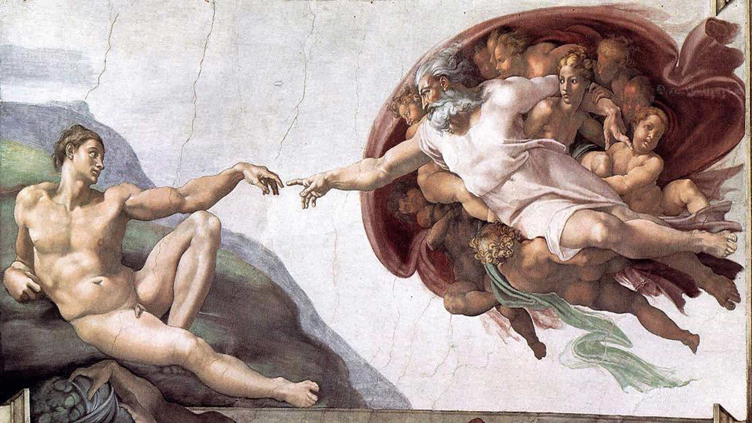
#1
The Holy Spirit as the Creative power of God

Slide 15
The Holy Spirit preserves creation.
The Holy Spirit sustains life.

Slide 16
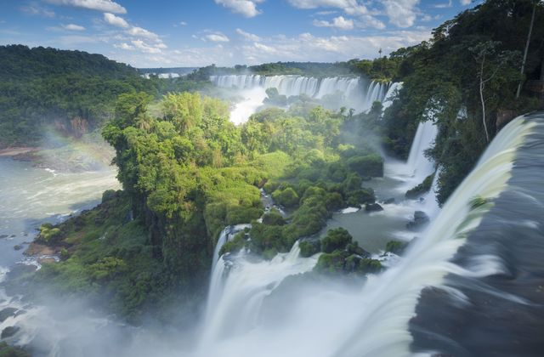
Only God can make things that are so beautiful!

Slide 17
The Holy Spirit fills us with life and transforms us so that we are more like Jesus. This is something that we need to pray for in the weeks ahead.
The goal of
a Christian (a follower of Christ) is to be like Jesus- think like Him, act like Him,
live like Him.

Slide 18
“The angel answered, "The Holy Spirit will come on you, and the power of the Most High will overshadow you”
-Luke 1:35
Fun Fact:
St Luke wrote one of the 4 Gospels

Slide 19
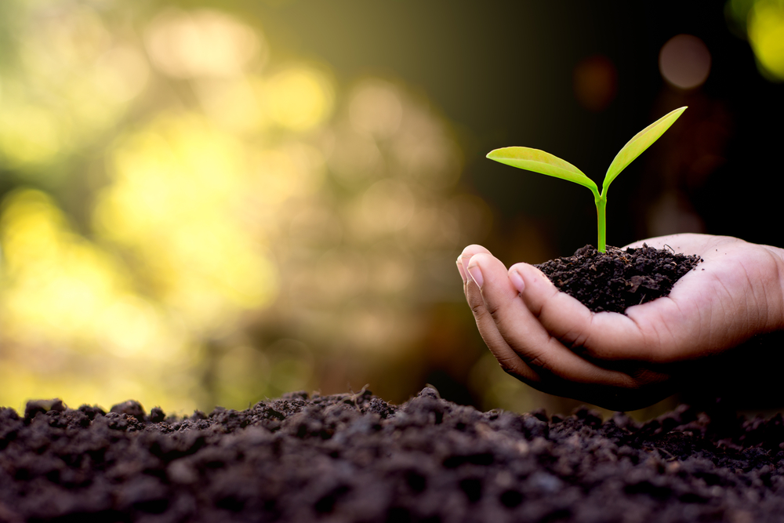
#2
The Holy Spirit is life-giving

Slide 20
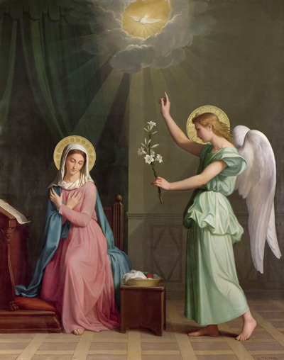
Mary was filled with the Holy Spirit. This enabled her to live her vocation from Nazareth to Calvary.

Slide 21
“When our hearts turn from God,” St Paul says, “we make the Holy Spirit sad”. (Eph. 4:30).
The Holy Spirit living in us, gives life to our soul
Say
YES to God.
Mary did.

Slide 22
When Jesus was baptised:
“…the Holy Spirit descended on him in bodily form like a dove. And a voice came from heaven: “You are my Son, whom I love; with you I am well pleased.”
-Luke 3:22
Fun Fact:
John, who Baptised Jesus, was the cousin of Jesus

Slide 23
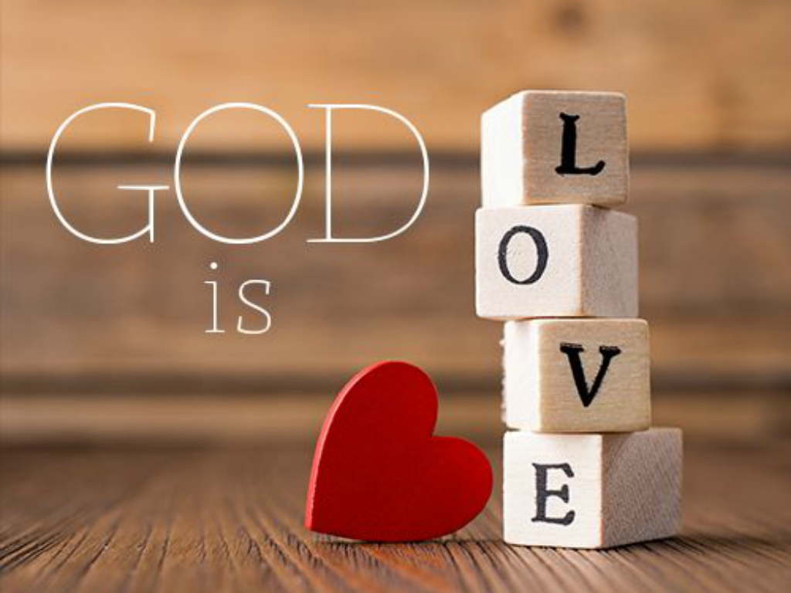
#3
The Holy Spirit is love

Slide 24
The Holy Spirit is the love between the Father and the Son. He is the love that Jesus brought to His mission of healing, forgiving sins, and preaching.

Slide 25
Love is much more than warm fuzzy feelings
It is a decision we make

Slide 26
We can choose to love when we’re at home or with our friends. We can choose to love in every moment.

Slide 27
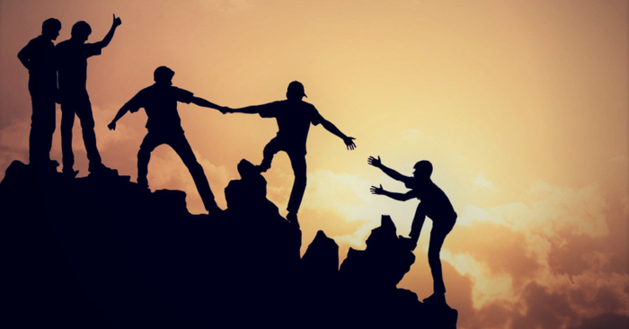
Love puts others first, and the Holy Spirit helps us do that.

Slide 28
“The Spirit of the Lord is on me, because he has anointed me to proclaim good news to the poor.”
-Luke 4:18
Fun Fact:
Anointing with oil is a sign of mission

Slide 29
#4
The Holy Spirit is the Energy for Mission

Slide 30
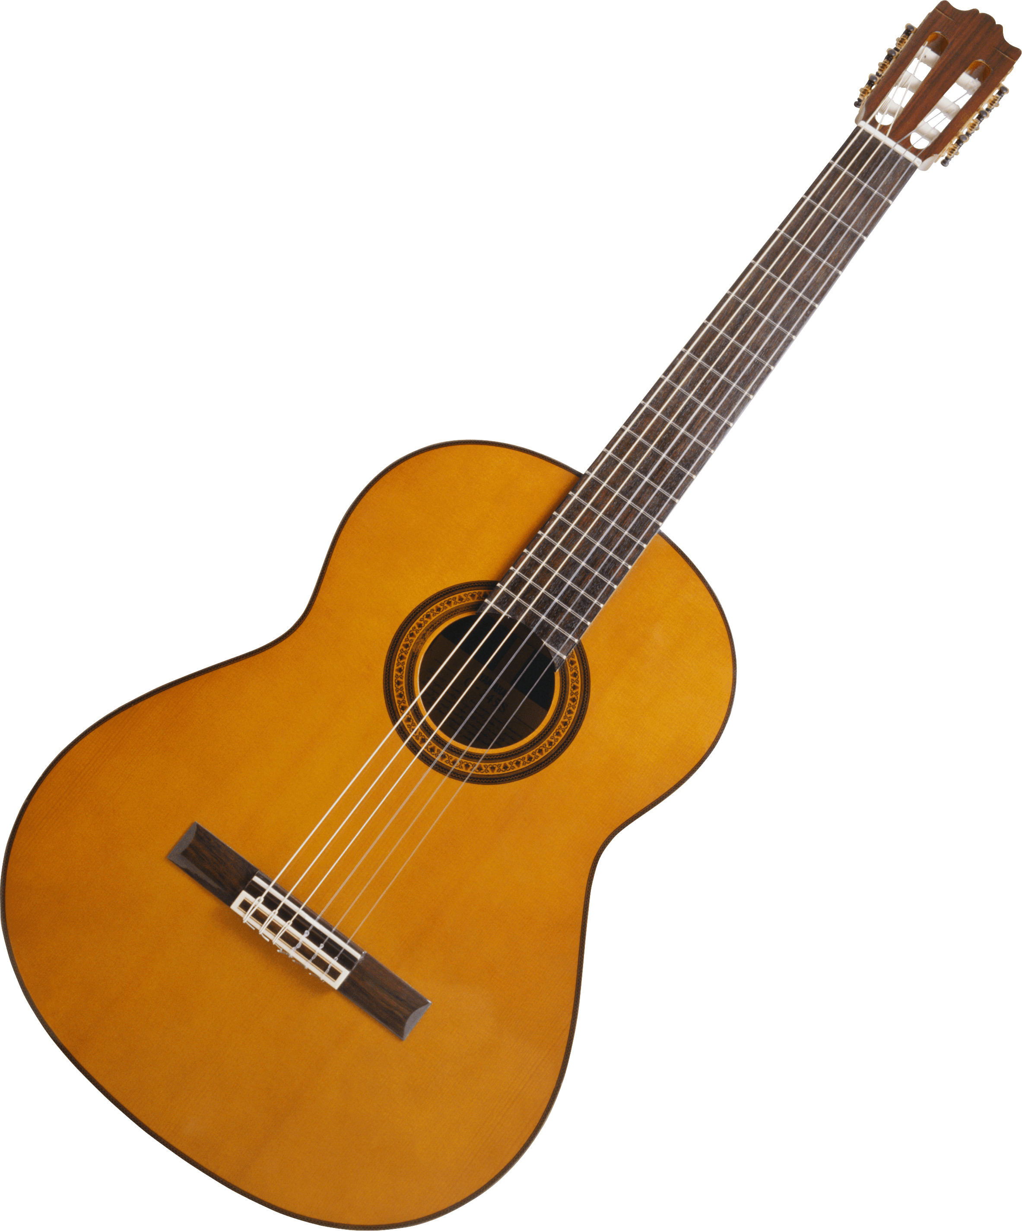
As we go through life we discover that God has given us many natural gifts. You might develop the gift of music, or sport or learn a language. What are your unique gifts?

Slide 31
The Holy Spirit also gives us “Spiritual Gifts” for our Mission:
wisdom, understanding, knowledge, courage, right judgement, reverence, wonder and awe in God’s presence
We will talk about them in more detail another day.

Slide 32
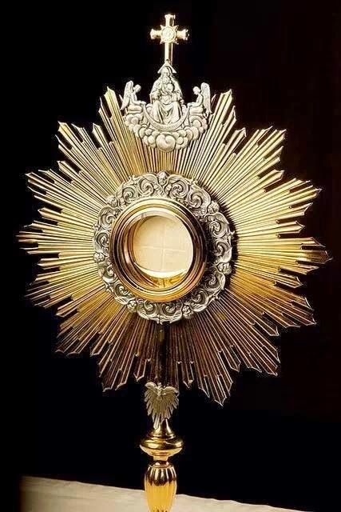
Your mission as a Christian is unique. The Holy Spirit will make it known to you gradually over your life time. But you need to ask Him.
“Come Holy Spirit; help me to know what God wants in my life.”

Slide 33
Until
next
time

