Slide 1
MESSAGE FROM: BISHOP KEVIN
CONFIRMATION 2019

Slide 2
Isn´t it amazing how much depth there is in Sacred Scripture? From just one passage, we have already learned about fear, spirit or breath, (ruah), and peace (shalom).
This time, we are going to talk about:
forgiveness.

Slide 3
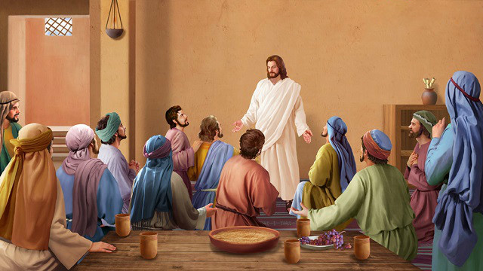
Let´s take another look at the Gospel: John 20: 19 -23
¹⁹ On the evening of that day, the first day of the week, the doors being shut where the disciples were, for fear of the Jews, Jesus came and stood among them and said to them, “Peace be with you.” ²⁰ When he had said this, he showed them his hands and his side. Then the disciples were glad when they saw the Lord. ²¹ Jesus said to them again, “Peace be with you. As the Father has sent me, even so I send you.” ²² And when he had said this, he breathed on them, and said to them, “Receive the Holy Spirit. ²³ If you forgive the sins of any, they are forgiven; if you retain the sins of any, they are retained.”
As you can see, immediately after the apostles receive the Holy Spirit from Jesus, he also gives them the power to forgive sins.

Slide 4
Forgiveness is something that is very important in our everyday lives.
We need to be forgiven for our sins, and we also need to learn to forgive others and ourselves.

Slide 5
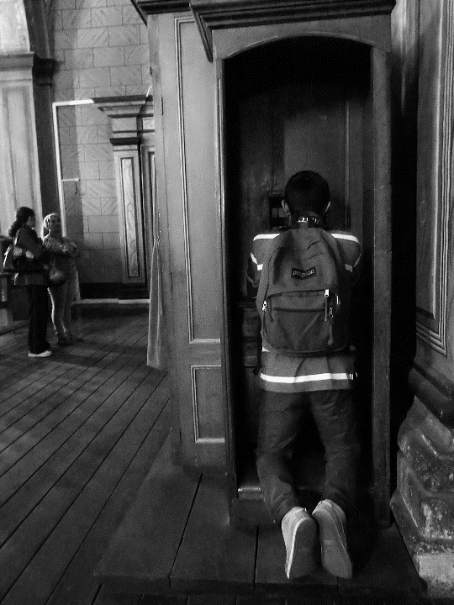
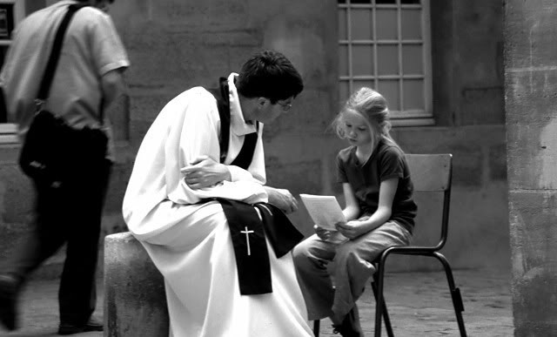
In the sacrament of reconciliation, Jesus forgives our sins through the priest.
It is very important that we go to confession often, and that we make good confessions.

Slide 6
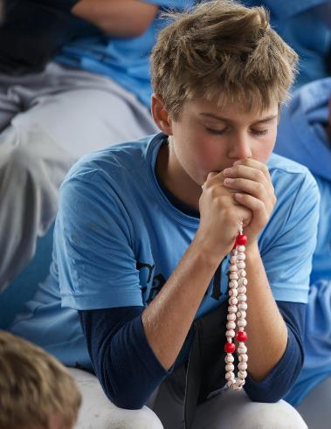
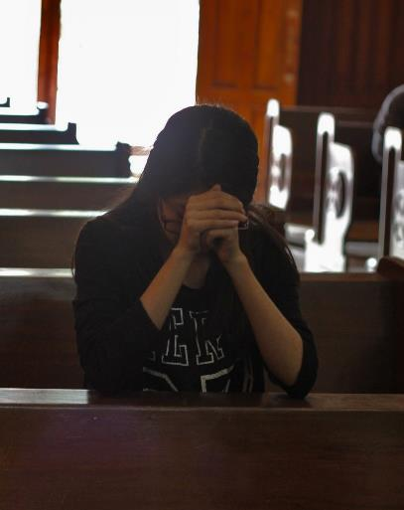
Do you know the five steps to making a good confession?
Step 1: Make a thorough examination of conscience.
This is when you take a few minutes to reflect on the sins you have committed since your last confession. It helps to do this in a quiet place where you can concentrate. You can also use an examination of conscience with questions to help you remember and examine yourself thoroughly.

Slide 7
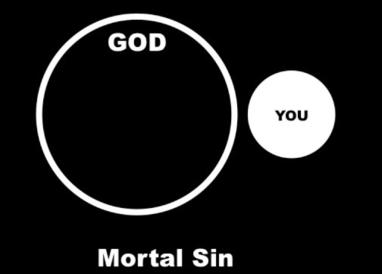
Don´t forget, not all sins are the same! When you examine your conscience, its very important to distinguish between the two different types of sins: mortal sin and venial sin.
Mortal sins are serious sins that close the door on God’s love. The door can only be opened from His side, when He prompts us to come and ask for His forgiveness. We lose the grace of God when we commit mortal sins.
A sin is mortal if:
1) It involves doing something that is extremely serious. In the Gospel Jesus told the Rich Young Man that the commandments he needed to follow to gain eternal life are: Do not kill, Do not commit adultery, Do not steal, Do not bear false witness, Do not defraud, Honour your father and your mother
2) It is something that I know and understand is very wrong
3) It is something I do with my full freedom, without being forced by anybody
You might ask, how can I tell the difference between a mortal sin and a venial sin?

Slide 8
The second type of sin is called venial sin. These sins are less serious, and they damage our relationship with God. You do not have to say all of your venial sins when you go to confession.
However, if you have committed any mortal sins, you must say them for the confession to be valid. If you knowingly leave them out, it´s as if you have not gone to confession.

Slide 9
But remember, do not be afraid to go to confession or to say that you´ve committed a mortal sin! The priest is used to hearing confessions and, like Jesus, does not want to punish you. When you make good confessions, you bring joy to the Heart of Jesus. He is always waiting for you to ask for forgiveness with open arms.

Slide 10
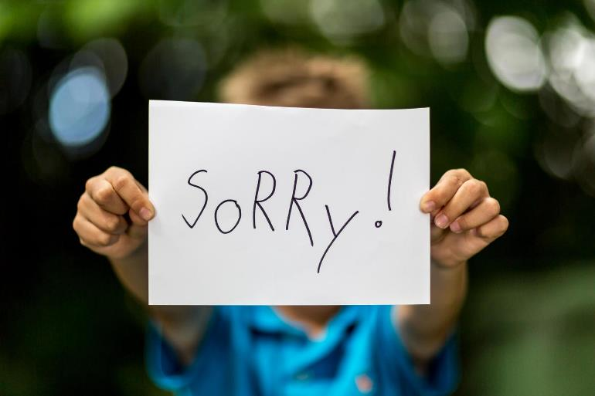
Step 2: Be sorry for your sins
We must be sorry for our sins because with our sin, we hurt ourselves, we hurt others, and most importantly, we offend God who loves us so much.

Slide 11
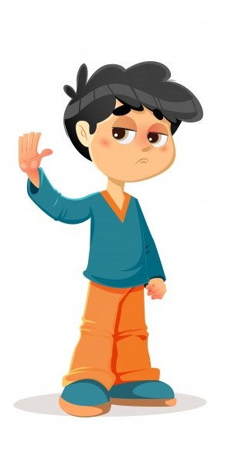
Step 3: Decide not to sin again.
When I receive the sacrament of reconciliation, I must make a firm decision to try my best not to commit the same sins again.
For example, if I say in confession that I watched a video that is inappropriate, but when I go home I am planning to do the same thing, this shows that I am not truly sorry.
Even though it’s normal that we make the same mistakes again, we should be trying to get better. If not, we are not making good confessions.

Slide 12
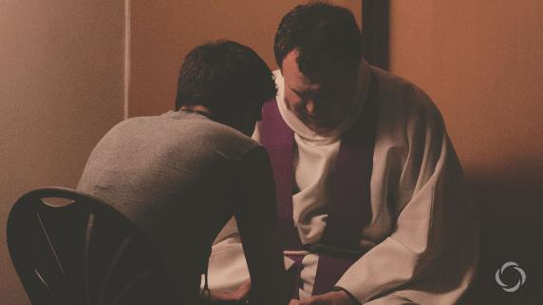
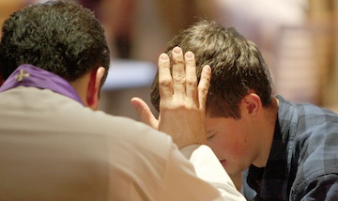
Step 4: Tell your sins to the priest.
This is when you actually go to confession and tell the priest your sins. It is good to tell him how long it has been since your last confession. When you finish, the priest will ask you to recite an act of contrition, for example:
“O my God, I thank you for loving me. I am sorry for all my sins, for not loving others and not loving you. Help me to live like Jesus and not sin again. Amen.”

Slide 13
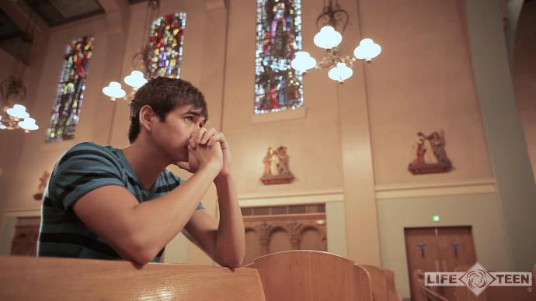
Step 5: Do your penance.
The priest will give you a penance to do to make up for your sins. Why do we have to do penance?
For example, if I steal from someone, if I later ask forgiveness I should also return what I stole to make up for what I have done. Penance works the same way. Its something that you do to make up for your sins. It helps us correct what we have done wrong, and builds up good habits within us.

Slide 14
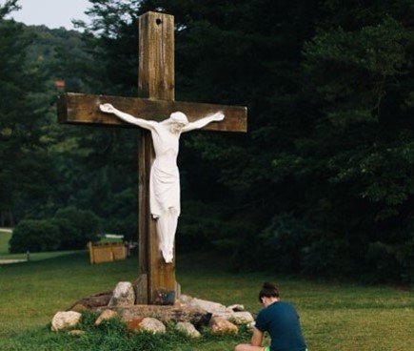
Those are the five steps to making a good confession!
Remember, we should go to regular confession! It would be a great idea to go once a month – in every confession, Jesus, in his mercy, cleans your soul and comes closer to you.
When we receive His mercy, we are able to be more merciful towards others.
He gives you extra strength to fight against temptation and sin, and to follow Him always.

Slide 15
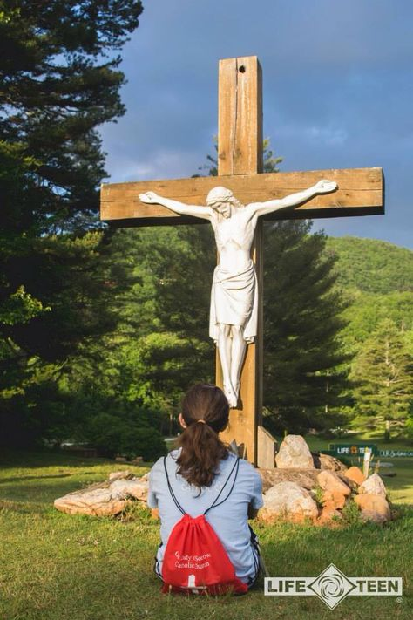
For followers of Christ, forgiveness is a part of everyday life.
We must forgive ourselves when we commit sins, even though at times we may feel ashamed. Don´t forget, you are a child of God, worth so much that He gave His life for you. He understands when we make mistakes and fall. If he has forgiven me, I must also forgive myself.

Slide 16
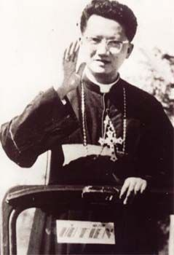
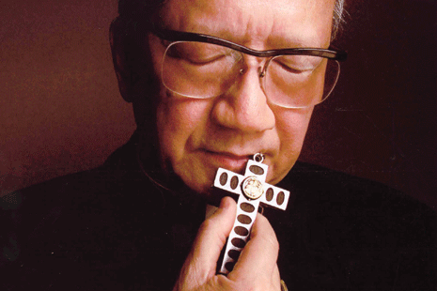
We must also forgive others. If Jesus has been forgiving and merciful with me, I must also be the same way with others, even when they hurt me. We have many great examples of forgiveness in the history of the Church. For example, there was a Bishop named Nguyen Van Thuan who lived in Vietnam in the 1970s.
Although he was innocent, he was taken prisoner and made to live in a tiny cell by himself for months. He suffered greatly during this time. The people in charge of guarding him did not believe in God or in the Catholic faith. Often they would come into his cell to insult him. But since this Bishop had a heart like the heart of Jesus, he would always forgive them and treat them as his friends instead of as enemies.

Slide 17
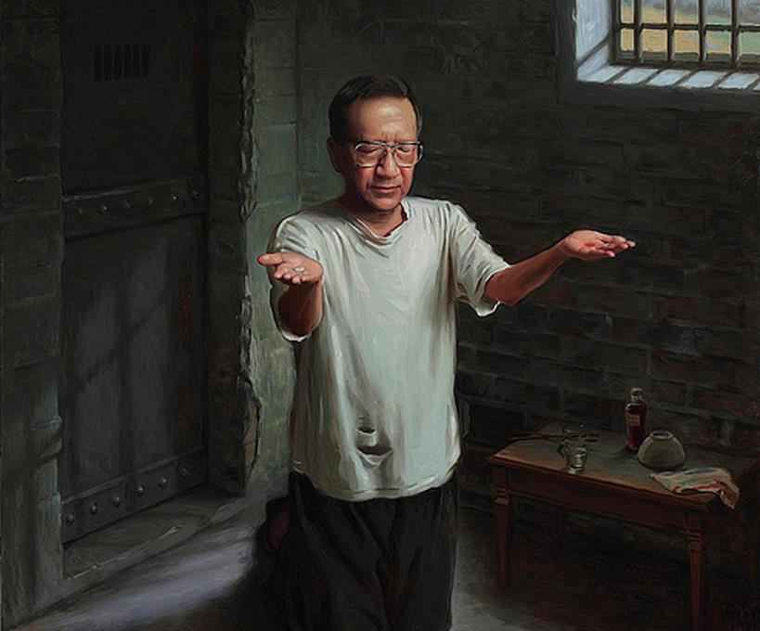
One day, one of the guards entered his cell with a hose and began to spray down the whole cell and the bishop, making him suffer even more from the freezing cold and insulting him. Bishop Van Thuan did not resist at all. Before the guard left, the Bishop called him a said, “Thank you for cleaning my cell.”
The guards were always astounded by the way the bishop would always forgive them, and even thank them. In fact, the prison was forced to continually change the guards, because they would always convert and want to become Catholic after seeing the Bishop´s testimony of forgiveness!

Slide 18
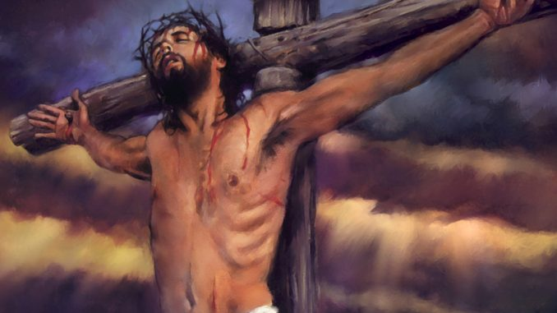
However, the best examples we have of forgiveness are Jesus himself, and His Blessed Mother Mary.
Jesus allowed Himself to be imprisoned, insulted, mocked, crowned with thorns, and hung on the cross by the very people He wanted to save. Jesus is God, and when He came to earth to save the people He had created, they responded by nailing Him to the cross. He had to power to stop them, but in His mercy and goodness, he never resisted.

Slide 19
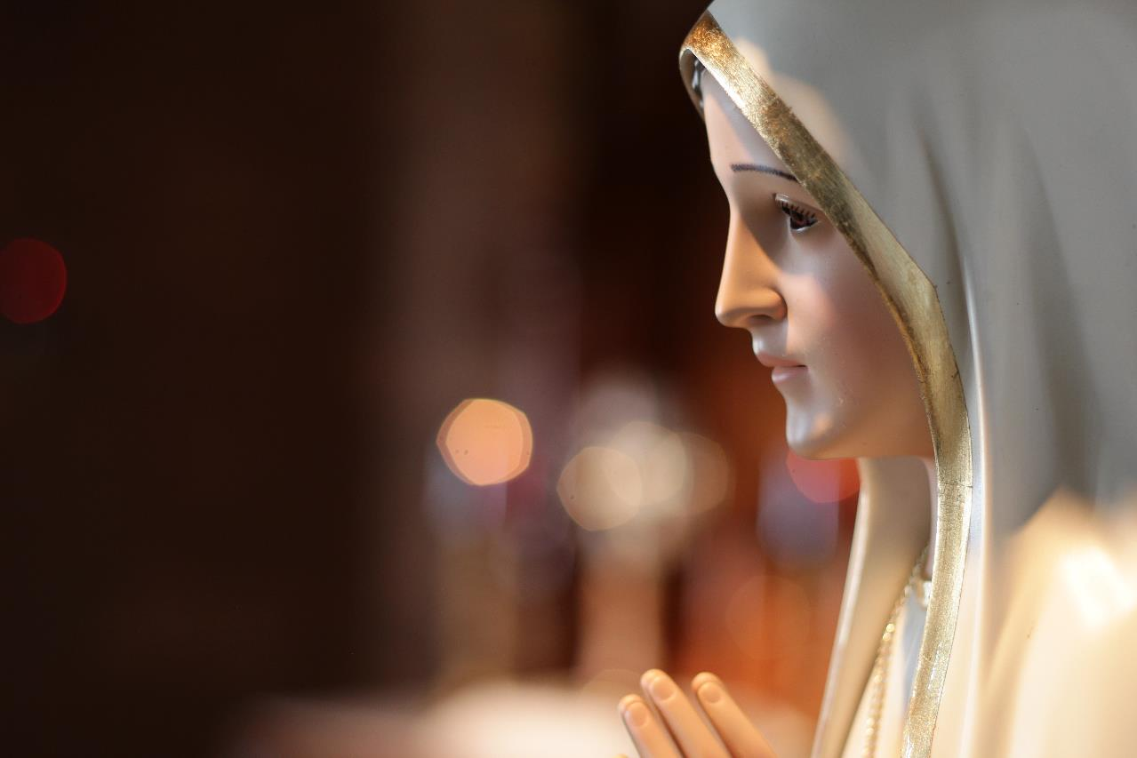
Mary, His Mother and our Mother, suffered very much seeing her son crucified.
And even though He died to save us from our sins, she still loves each of us as her children and does all she can to help us get to Heaven. Mary is always interceding for us.

Slide 20
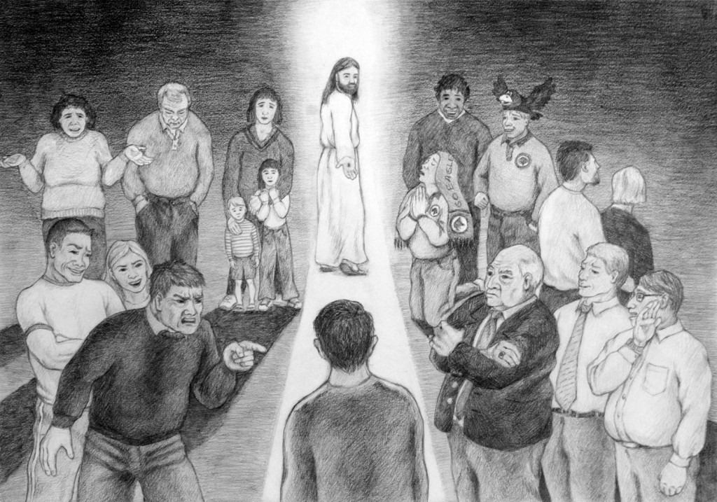
If Jesus forgave those who crucified Him, and he also always forgives us, we must also always forgive others.
Are you willing to follow in the footsteps of Jesus, and forgive like He did? Will you surrender your life for others like He did? Even when others persecute you?

Slide 21
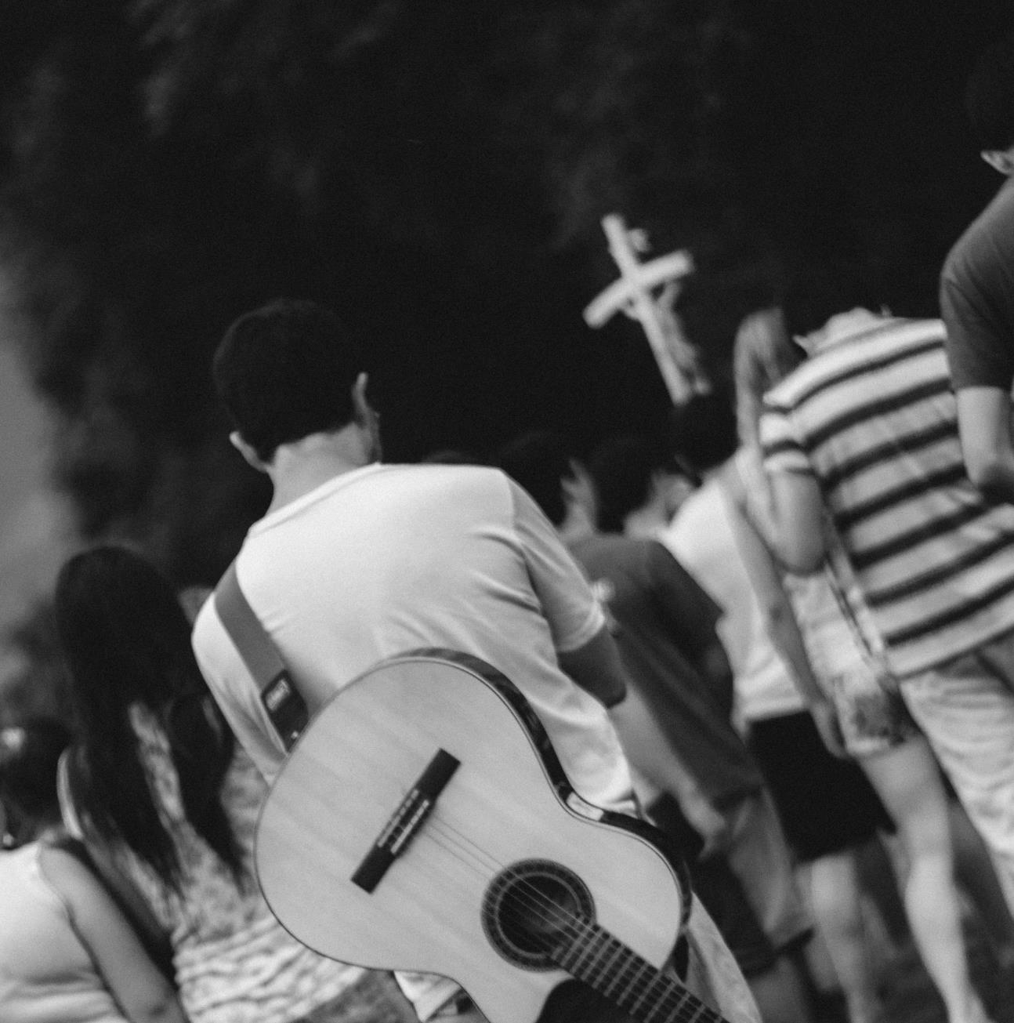
The Holy Spirit will give you the strength to do so! It´s all part of being a true disciple of Jesus. Lets all pray together now, asking the Holy Spirit to fill us with his love and forgiveness.
O Holy Spirit, Jesus freely chose to suffer and die for me because of His great love for me. I have pains in my life - hurts, wounds, sufferings, difficulties. Teach me to forgive. Strengthen me to follow in Jesus’ footsteps so that I can walk my road to Calvary without fearing evil. Renew me, and lead me into my new life of victory and resurrection. Amen.

Slide 22
And don´t forget to check out my latest video message!
Here´s the link:
https://www.elphindiocese.ie/ambassadors/

