Slide 1
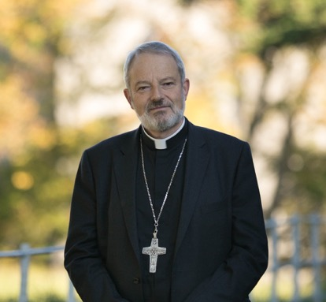
The Holy Spirit will come upon you…the POWER of the Most High will overshadow you…
Message from Bishop Kevin: Confirmation 2018

Slide 2
Have you ever stopped to observe the world around you?
It’s FULL of God’s
creatures!

Slide 3
Do you have a favourite animal?

Slide 4
A favorite landscape?
“Saint Francis always left one part of his garden untouched, so that wildflowers and herbs could grow there, and everyone who saw them could raise their minds to God, the Creator of such beauty”. – Pope Francis, Laudato Si

Slide 5
God made all these things out of love for mankind…
…Out of love for YOU!

Slide 6
People can use God’s creation to make many things.
God wants us to use his creation, but in an ordered and responsible way.

Slide 7
When you are Confirmed in a few weeks, you are going to receive the gift of the Holy Spirit called KNOWLEDGE.
This gift will help you see created things as God intended.

Slide 8
The gift of knowledge isn’t about knowing a lot of facts. It is about reaching God through his creation, using creatures to reach the Creator.
It helps us to see things in a more spiritual way.

Slide 9
KNOWLEDGE in the life of St. Francis de Sales
Francis de Sales was born at the Chateau de Sales in Swiss Savoy on August 21, 1567. From a very young age, Francis knew that He wanted to give his life totally to God. He was obedient, truthful, and habitually generous to those less fortunate than himself.
He was ordained a priest at the age of 26, and later became the Bishop of Geneva.
One of the missions that Bishops have is preaching. When Francis preached, he would often use examples from nature to teach his people spiritual things. He loved God’s creation, and used it to bring others closer to God.

Slide 10
For example, St. Francis de Sales taught that we must be like sunflowers.
Have you ever noticed that sunflowers always move to face the sun?

Slide 11
Like the sunflowers, we turn to Jesus in prayer. He is the One who gives us Life.

Slide 12
KNOWLEDGE in the life of St. Jane Frances de Chantal
St. Jane Frances de Chantal was a very close friend of St. Francis de Sales. Jane was born into a rich family, but had no desires for the riches and applause of the world. She got married at the age of 21 and had four children. At the age of 28 her husband passed away in an accident.
A few years later Jane met St. Francis de Sales, and he taught her all about the spiritual life and about how it is more important to please God than to please people.
Together with St. Francis, St. Jane began a new congregation that cared for the poor and the sick.

Slide 13
Near the end of her life, St. Jane went through a very difficult time. First, her friend St. Francis de Sales died, and soon after her son was killed in a war. A few years later, the plague that was going through France killed her daughter-in-law and her son-in-law.
Jane suffered very much during this time, but with the help of the gift of knowledge, she never lost her faith in the love and goodness of God.
The gift of knowledge helped her understand that life on this earth does not last forever, and that God gave her a family and friends to help her get to Heaven, our true Home. Heaven is where we will be truly happy for all eternity.

Slide 14
The gift of KNOWLEDGE in your life
In our own lives, we must learn to love created things in the way that God wants. Neither deficiently (too little), nor excessively (too much).
For example, if I treat my parents or my siblings badly, I am loving deficiently (too little).
If I become obsessed with things like money or my mobile phone, or sports, - and I place more importance on them than on God, then I love them excessively (too much).

Slide 15
Things like your family, friends, your favourite sports and activities, and material possessions are not bad things. But they must be used and loved in the correct way. The gift of knowledge reminds us that these things don’t last forever – only God is eternal! The things that God gives us on earth should help us reach Heaven.
The key to the question is loving God first, and loving God the most. If we do so, we will love all of God’s creation in the correct way.

Slide 16
The gift of knowledge is very important because once you know, then you can act. Another gift of the Holy Spirit that you are going to receive is called Right Judgement. This gift helps us to recognise the difference between right and wrong, and gives us proper judgement.

Slide 17
It helps us be prudent, allowing us to act promptly and appropriately, even in difficult situations, pointing the right way forward.

Slide 18
It inspires us to speak up and encourage others to do the right thing.

Slide 19
RIGHT JUDGEMENT in the life of St. Maximilian Kolbe
St. Maximilian Kolbe lived in Poland during the Second World War. From the time he was a small child he had a very great love for our Blessed Mother. At a very young age he became a Franciscan Friar.
All of the other Friars loved Maximilian. They would say that he had the firmness of a father, and the gentleness of a mother at the same time. He did lots of apostolate to spread the word of Jesus, including printing a magazine about the Catholic faith that spread to many different countries. He also worked hard to give shelter to thousands of refugees during the war.

Slide 20
On February 17, 1941, Maximilian was taken prisoner by the Nazis and brought to a concentration camp.
One day in the concentration camp, the Nazis ordered that ten prisoners were to be executed. Maximilian was not chosen as one of the ten. However, he heard one of them cry out “Oh, what will become of my wife and my children!” Immediately, St. Maximilian stepped forward and offered to go in the place of the man who had cried out. His offer was accepted, and St. Maximilian died giving his life for another. Up until the last moment, St. Maximilian encouraged the other prisoners to not lose hope and trust in God, because they would soon be in Heaven.
St. Maximilian Kolbe was able to make that courageous act thanks to the gift of right judgement, which helped him to react quickly in a difficult situation.
St. Maximilian was canonised by the Pope in 1971. The man that he saved, Franciszek Gajowniczek, survived the Nazi concentration camp and was present in the canonisation of St. Maximilian.

Slide 21
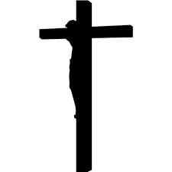
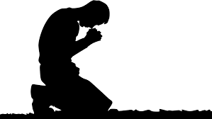
The Gift of Right Judgement in Your Life
In your own life, right judgement will help you know how to react in tough situations,
defend your faith,
and help others to do the right thing.
recognise right and wrong,

Slide 22
For example, if I am with people who are gossiping or speaking badly about others,
the gift of Right Judgement will help me to react by not taking part in the conversation. The Holy Spirit gives us extra strength to be faithful in our daily lives, and He always rewards us for doing what is right.

Slide 23
Don’t forget, its worth it to follow Jesus!
When you are faithful to what He asks of you, He gives you peace in your heart and true happiness, even though at times you may have to make difficult decisions.
“Father, into your hands I commend
my spirit.”Lk 23:46

Slide 24
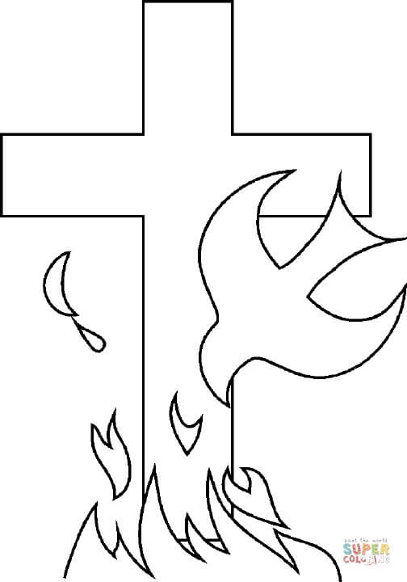
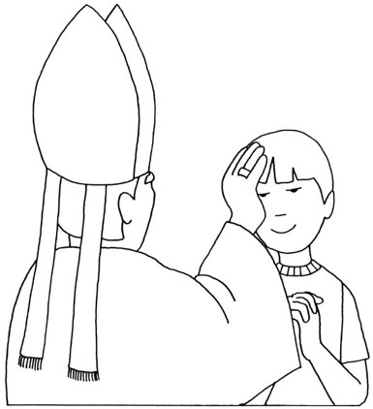
Both Knowledge and Right Judgement are very important if you want to be a true follower of Jesus. Don’t forget to ask the Holy spirit for these gifts as you prepare for your confirmation. He wants you to have them!
"Ask and it will be given to you; seek and you will find; knock and the door will be opened to you.” Matthew 7:7
Oh, Holy Spirit,
Love of the Father and the Son,
Inspire in me always
What I should think,
What I should say,
How I should say it,
When I should keep silent,
How I should act,
And what I should do
For the glory of God,
The good of souls,
And my own holiness. Amen.

Slide 25
Go to this link to watch Bishop Kevin’s video message about the gifts of Knowledge and Right Judgement:
https://www.elphindiocese.ie/ambassadors/

